Slide 1

Exploratory Data Analysis of Fuel Futures Markets
Price behavior trends | Volatility | Trading volume

Slide 2
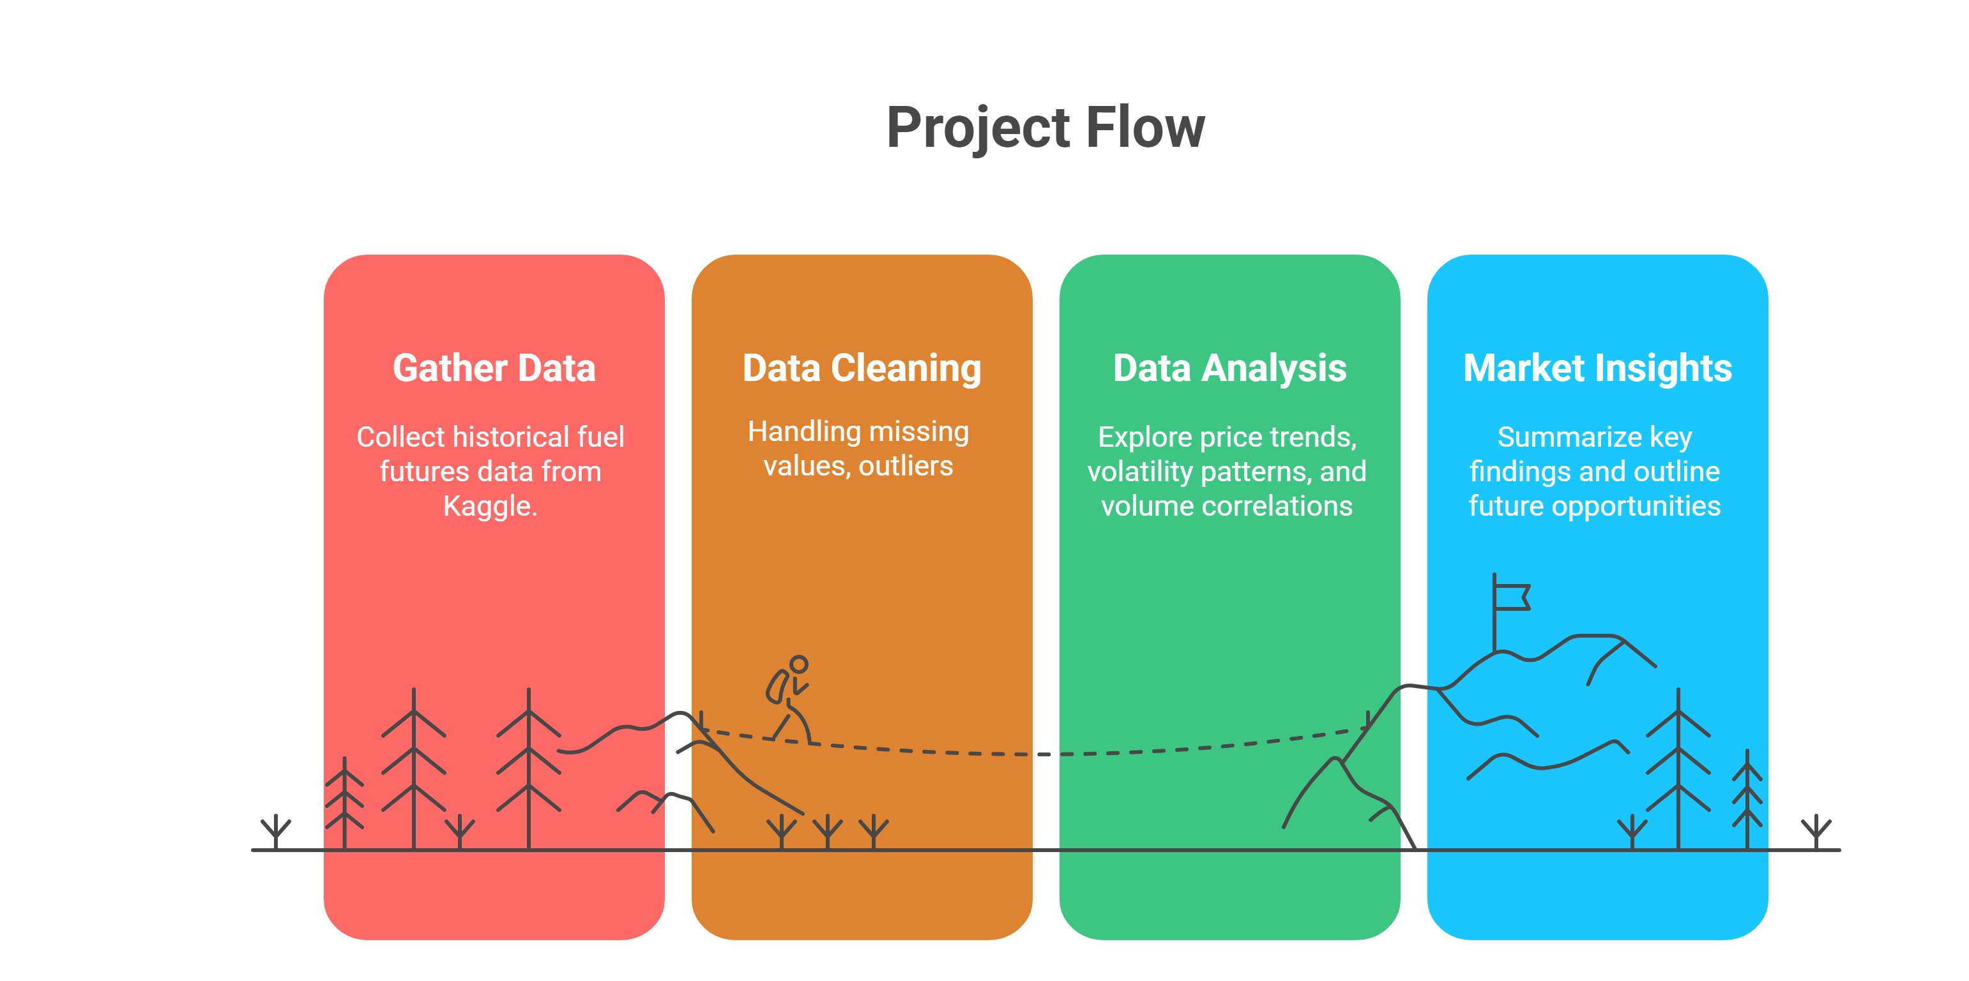
Project Overview
This project explores historical fuel futures data to uncover trends, volatility patterns, and trading behavior across key commodities.
The goal is to understand market dynamics and lay the foundation for future trading strategies.

Slide 3
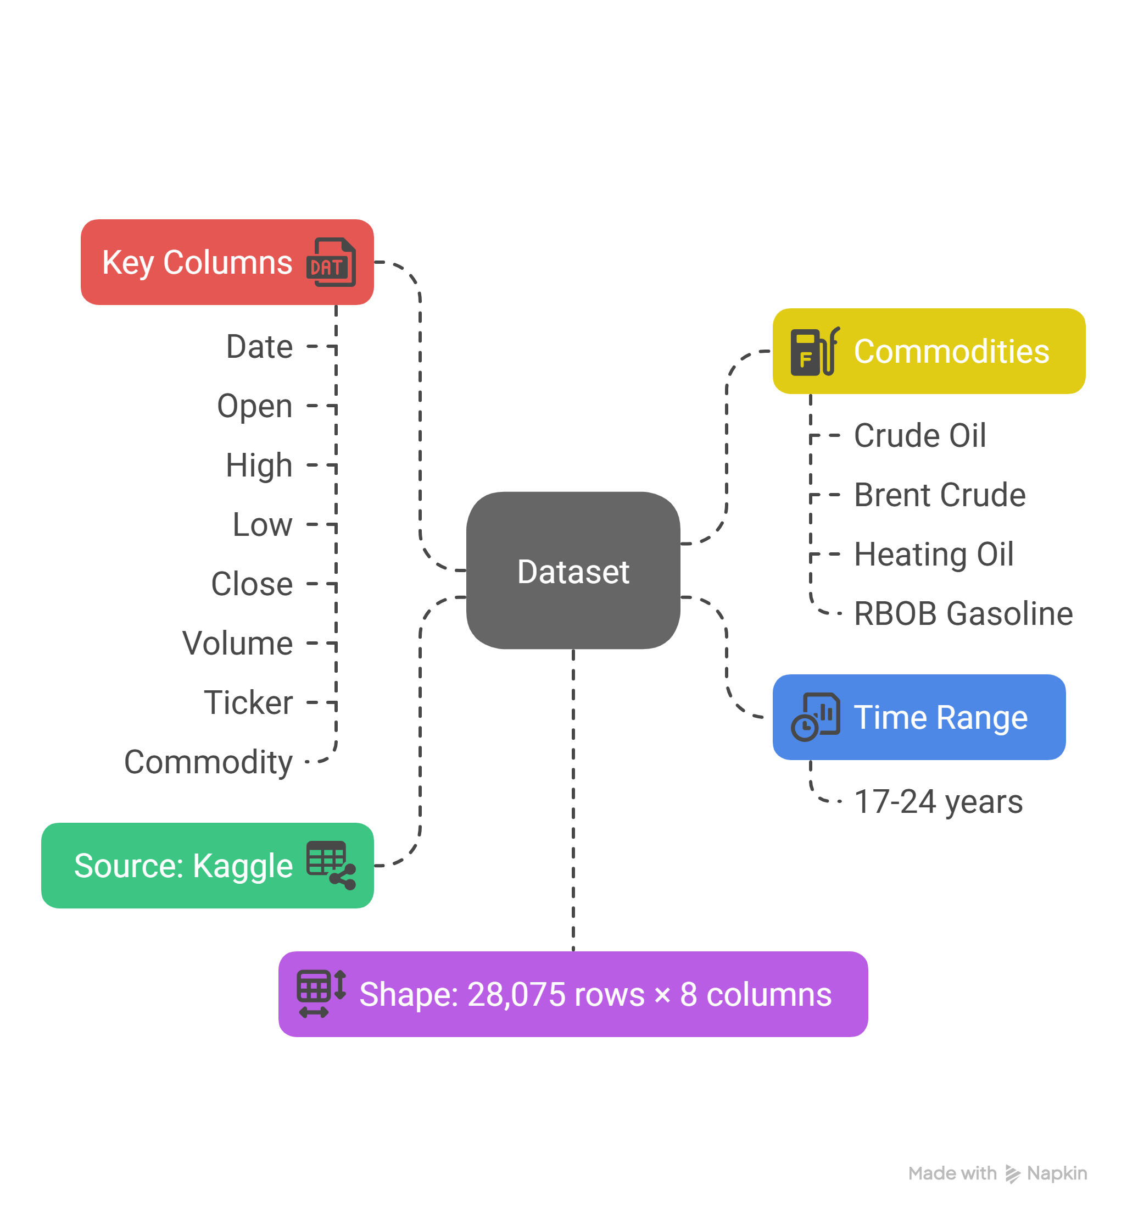
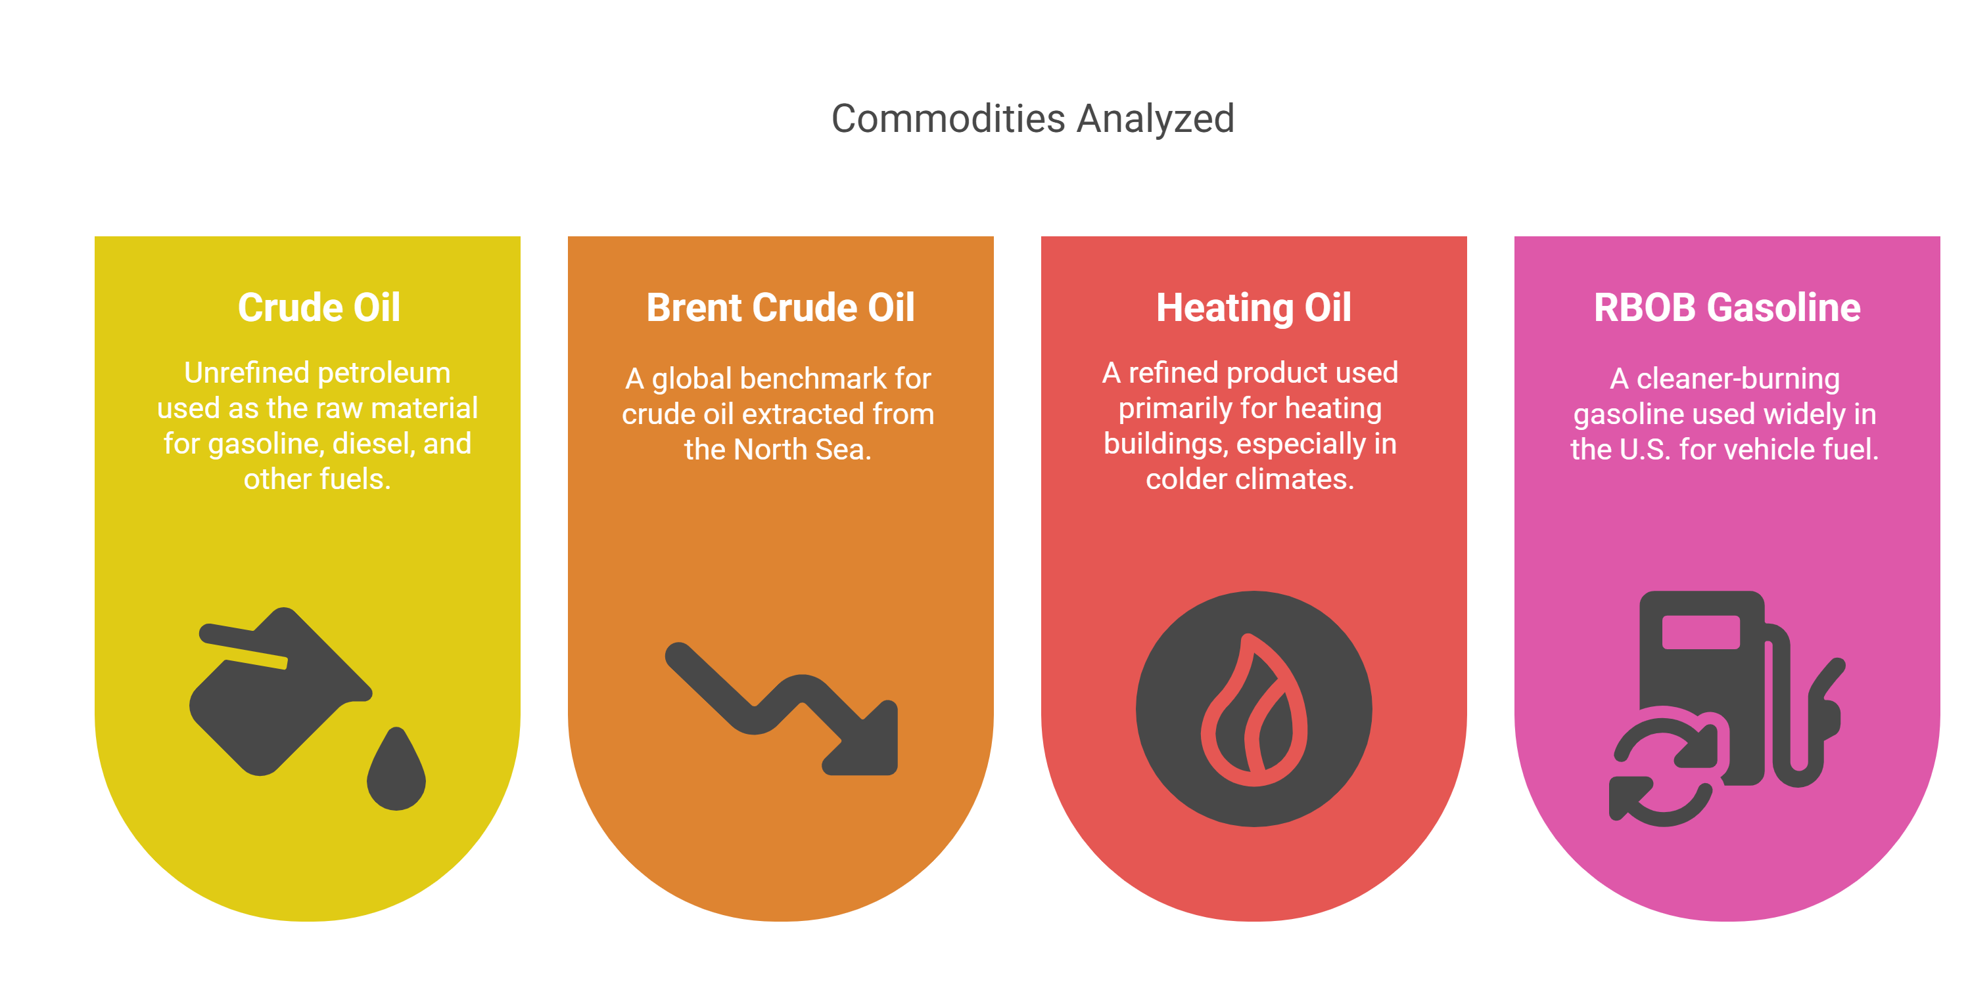
Dataset Overview

Slide 4
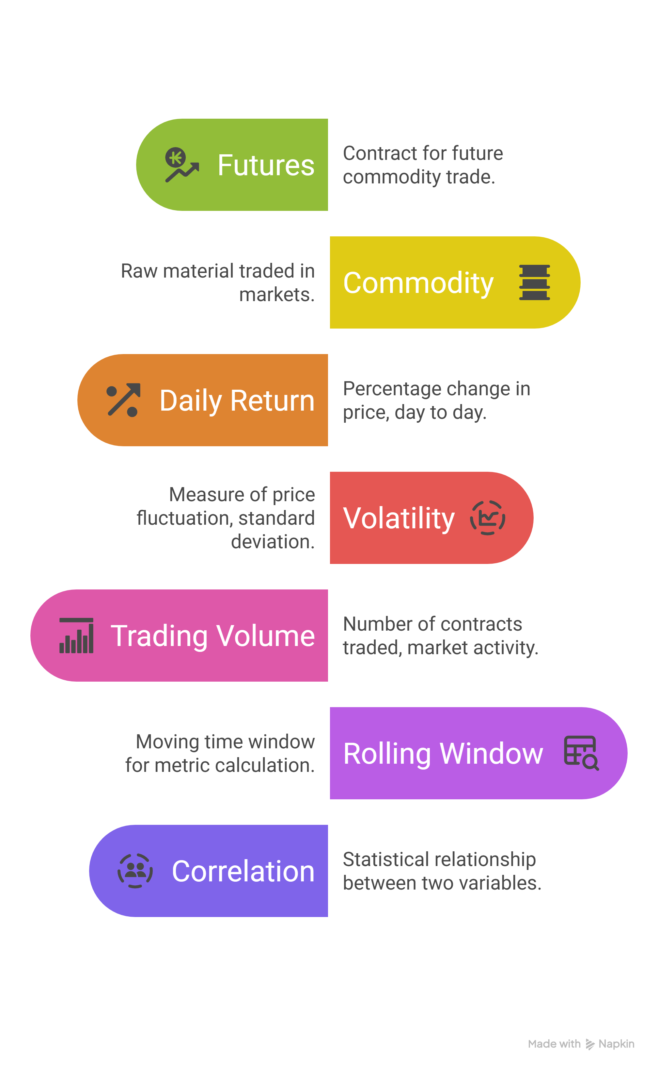
Terminology for Non-Experts

Slide 5
Problem Statements
Correlation Analysis
How correlated are the prices of the commodities?
Are trading volumes across different commodities correlated?
Price Behavior & Volatility
Which commodities exhibit the highest price volatility over time?
Are there consistent periods of high or low volatility throughout the year for specific commodities?
Liquidity
What is the relationship between trading volume and price volatility?
Trading & Profitability (Future Scope)
What is the best trading strategy for fuel futures to maximize profitability?

Slide 6
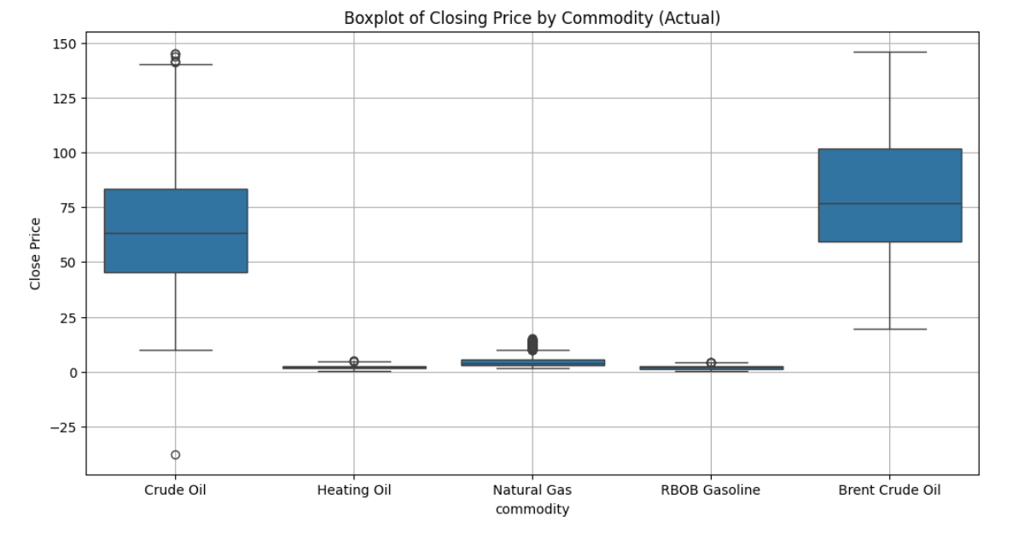
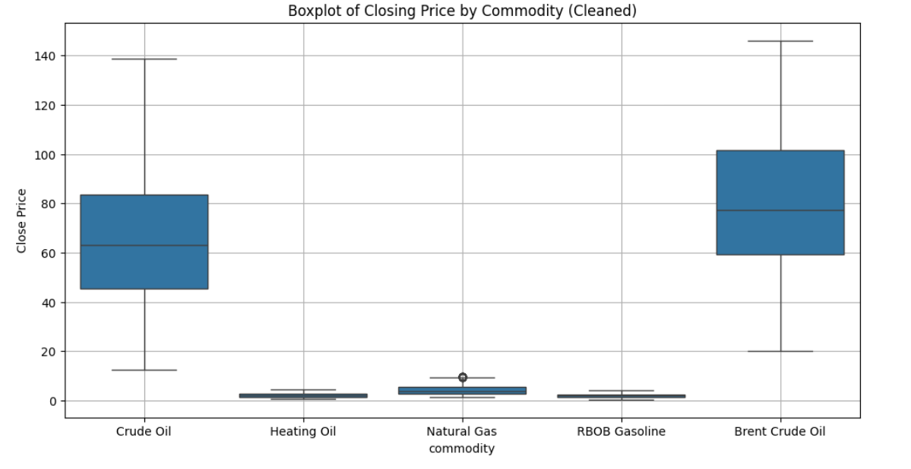
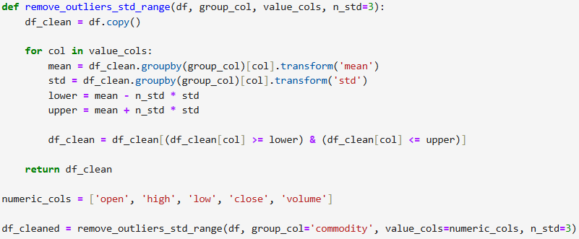

Data Cleaning and Preprocessing
The dataset does not contain any null values or duplicates.
The outliers were treated using the Z-score technique as shown in the pictures.

Slide 7
Section 1: Correlational Analysis
How correlated are the prices of the commodities?
Are trading volumes across different commodities correlated?

Slide 8
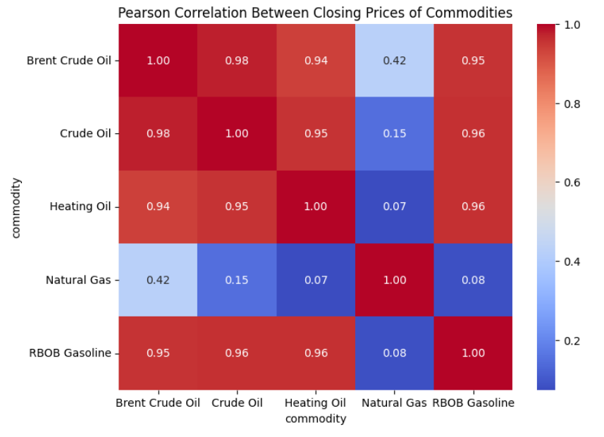
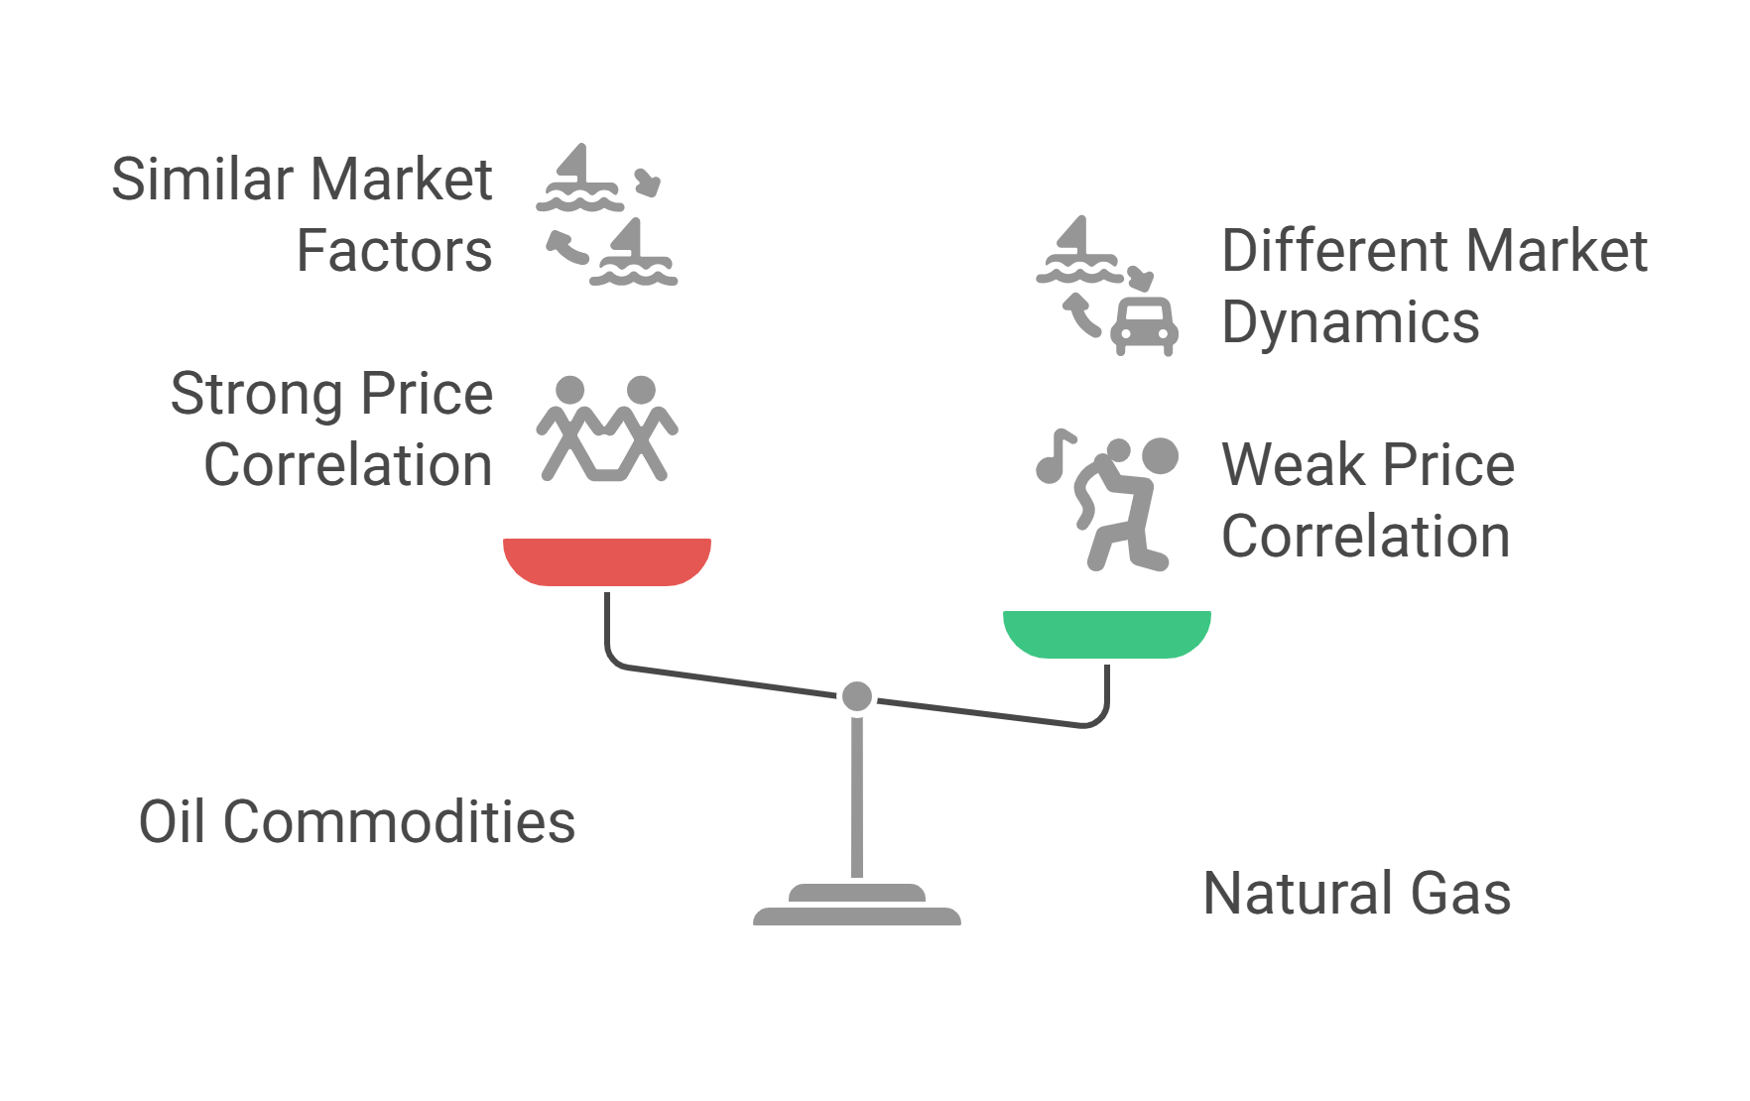
How correlated are the prices of the commodities?
Observations

Slide 9
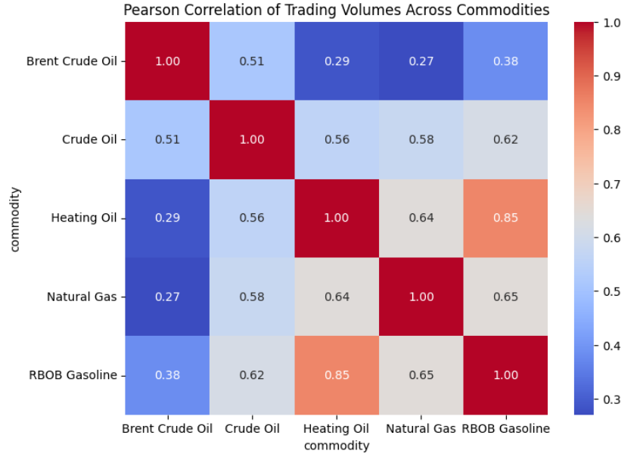
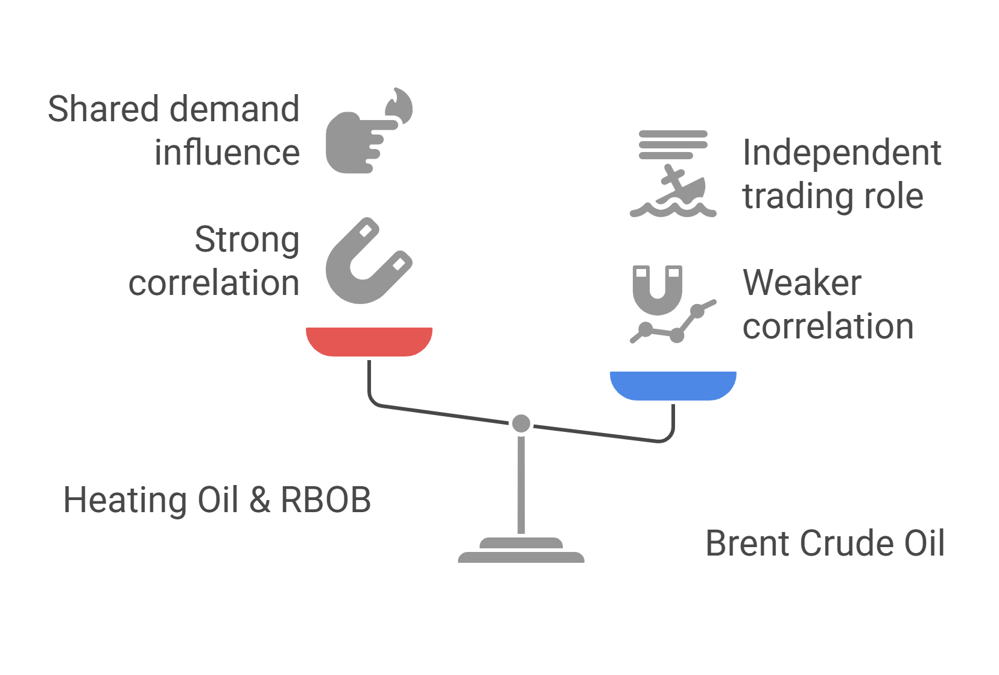
Are trading volumes across different commodities correlated?
Observations

Slide 10
Section 1: Conclusion
Natural Gas appears to behave independently from the other commodities in terms of price movements. For investors, this means that adding Natural Gas to an energy-focused portfolio could help reduce risk through diversification.
Some commodities show closely linked trading volumes due to shared demand patterns, while others, like Brent Crude, follow their own trading behavior. This highlights the diversity in how energy commodities are traded in the market.

Slide 11
Section 2: Price Behavior and Volatility
Which commodities exhibit the highest price volatility over time?
Are there consistent periods of high or low volatility throughout the year for specific commodities?

Slide 12
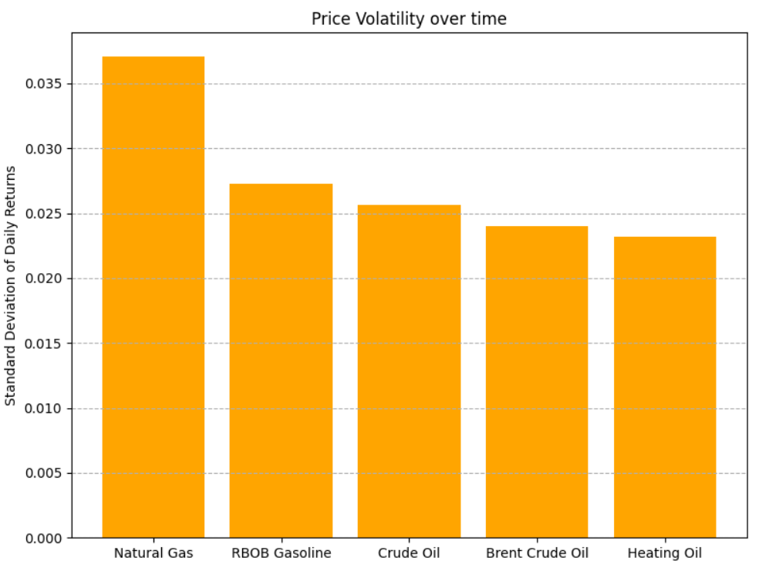
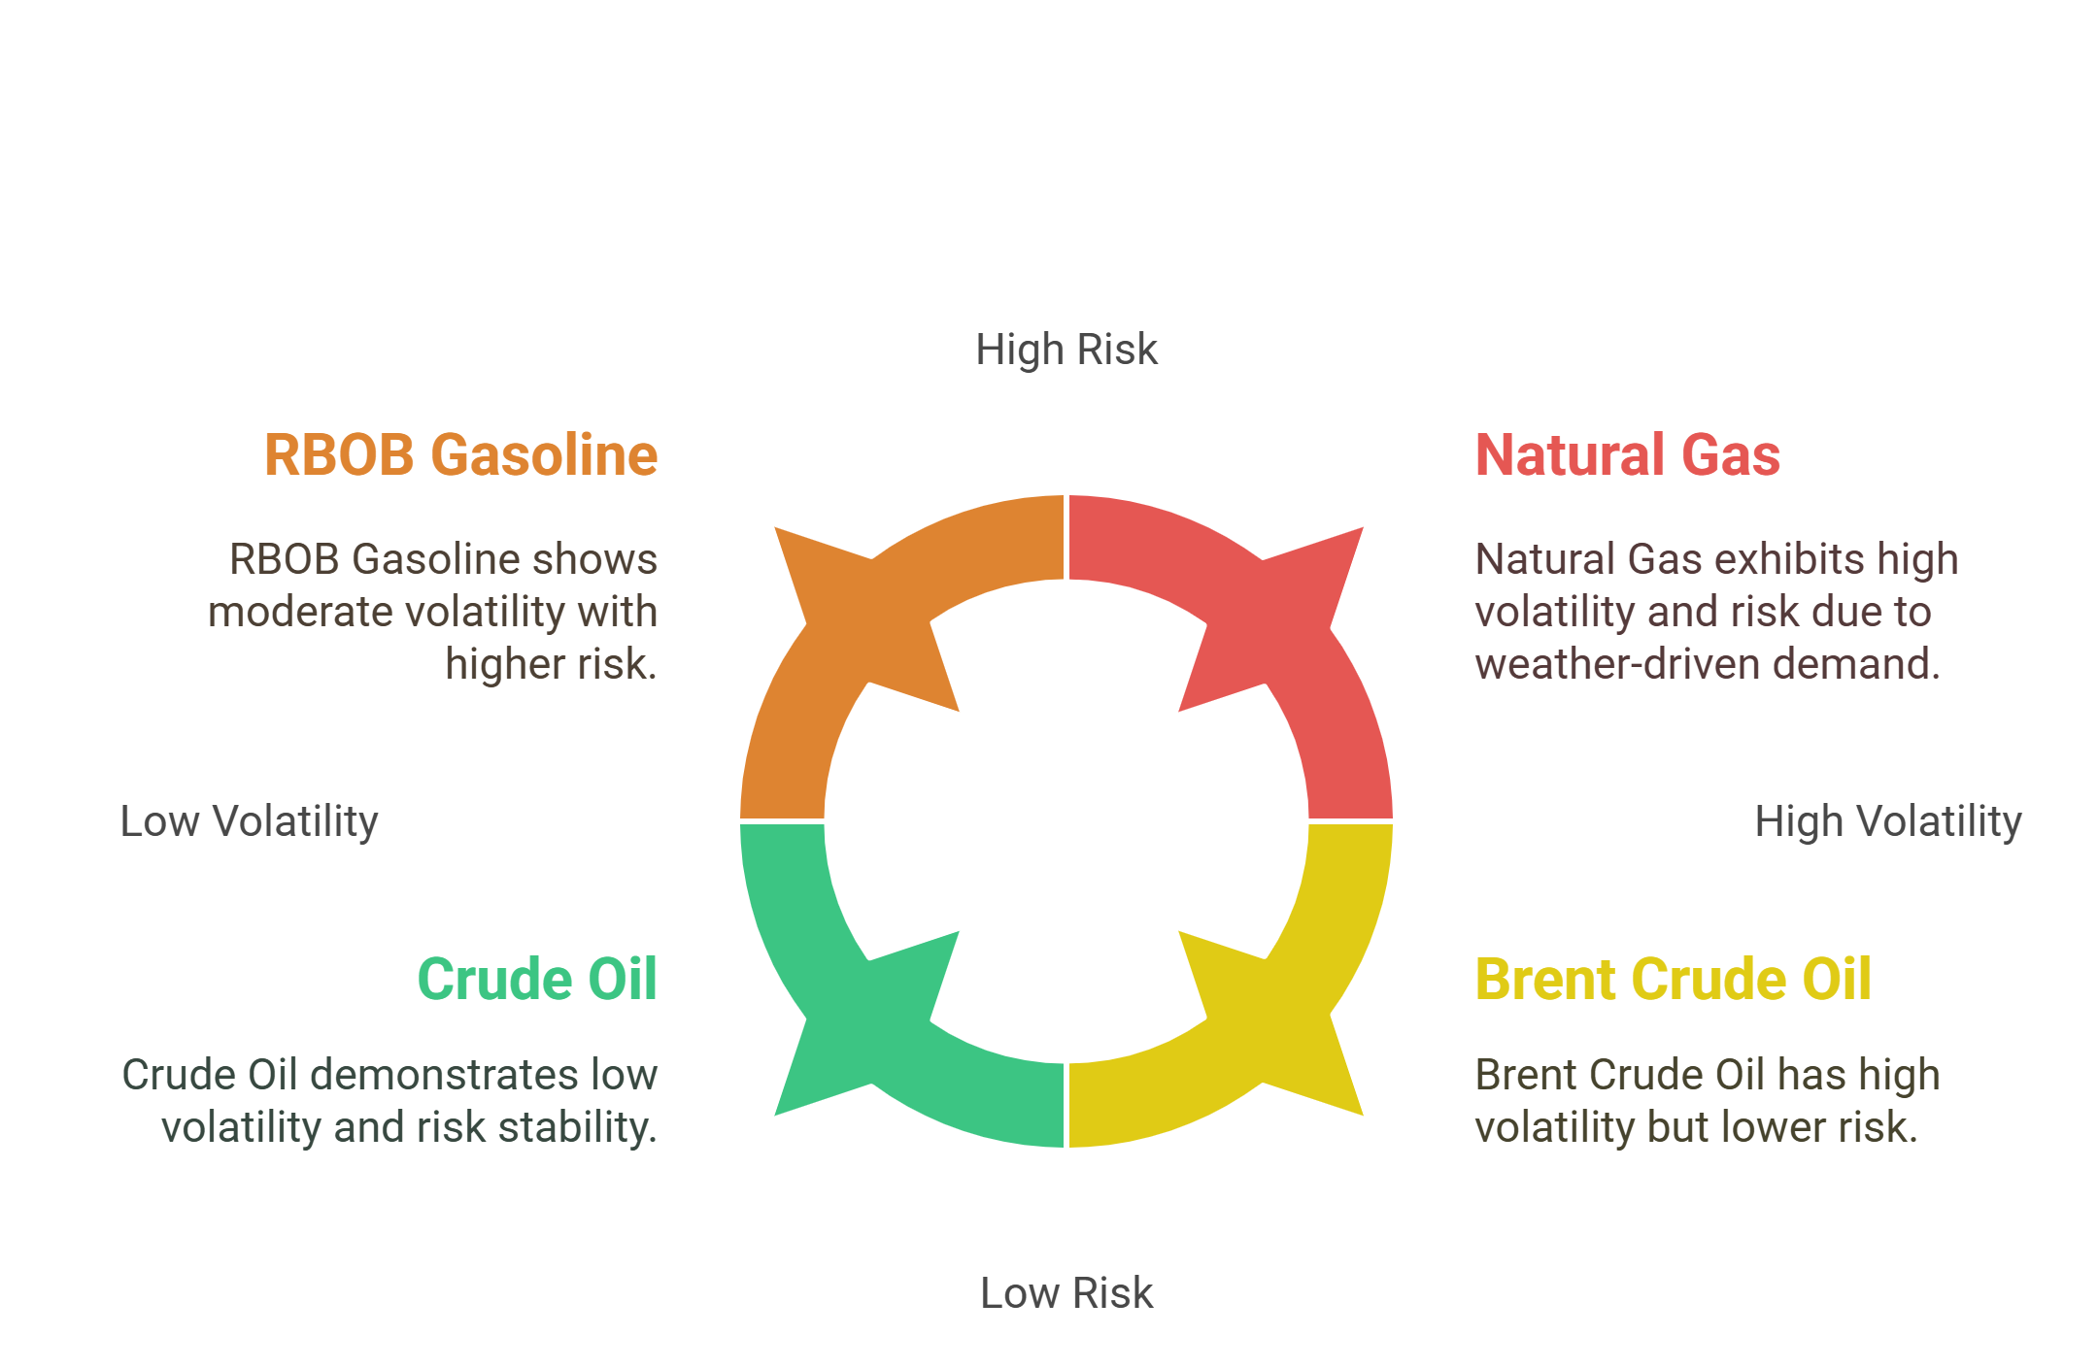
Which commodities exhibit the highest price volatility over time?
Observations

Slide 13
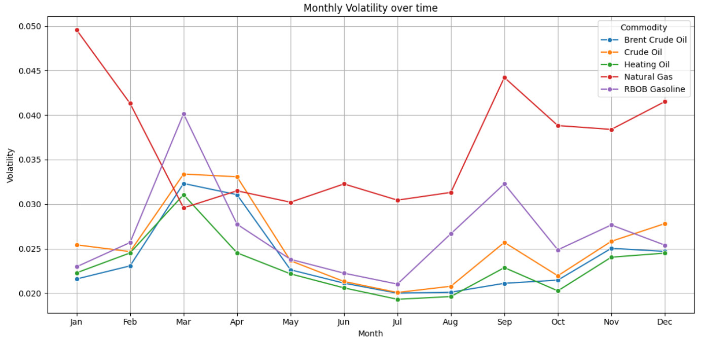
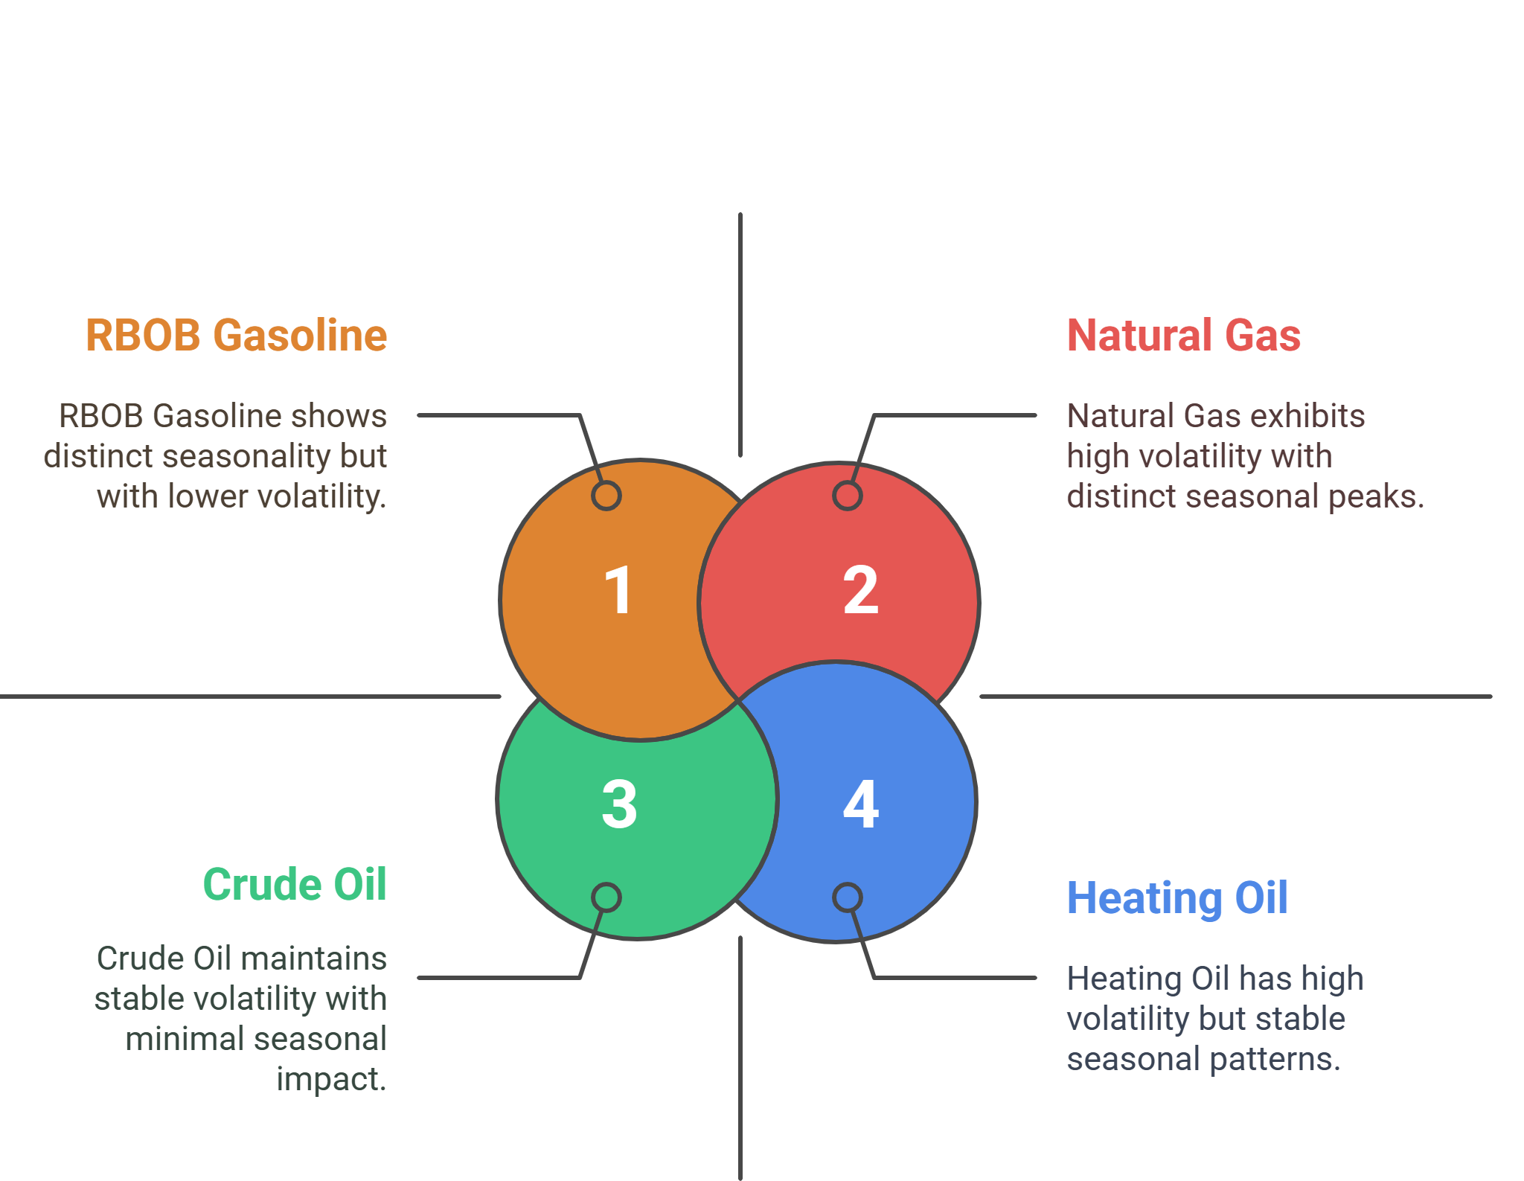
Are there consistent periods of high or low volatility throughout the year for specific commodities?
Observations

Slide 14
Section 2: Conclusion
Natural Gas is the most volatile commodity in this group, making it a higher-risk, higher-reward asset. Investors or traders dealing with energy commodities should consider this volatility profile when making portfolio decisions.
Some energy commodities, particularly Natural Gas and RBOB Gasoline, display clear seasonal volatility patterns, while others remain more stable across the year. These trends highlight the importance of seasonal factors such as weather conditions and consumer behavior in shaping market dynamics.

Slide 15
Section 3: Liquidity
What is the relationship between trading volume and price volatility?

Slide 16
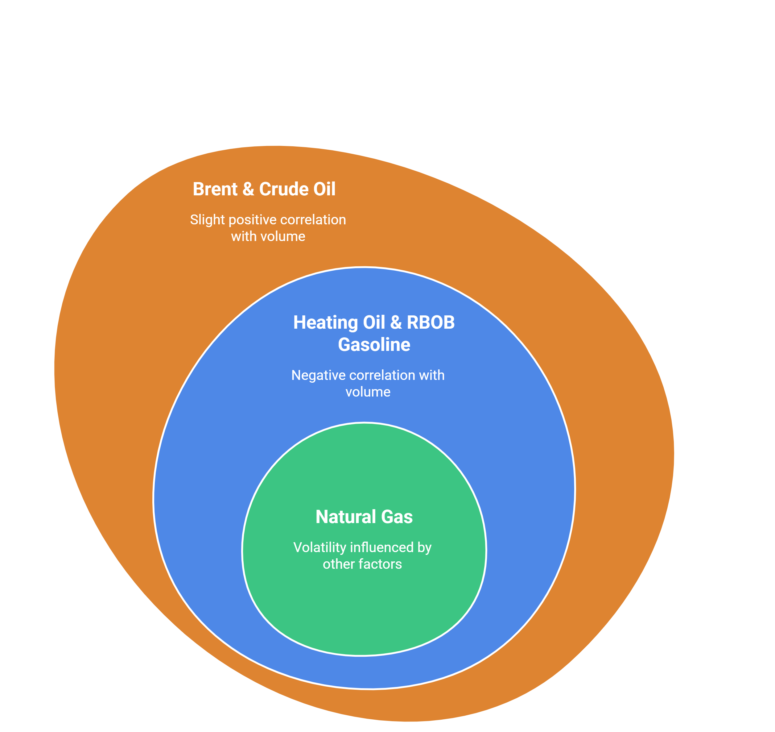
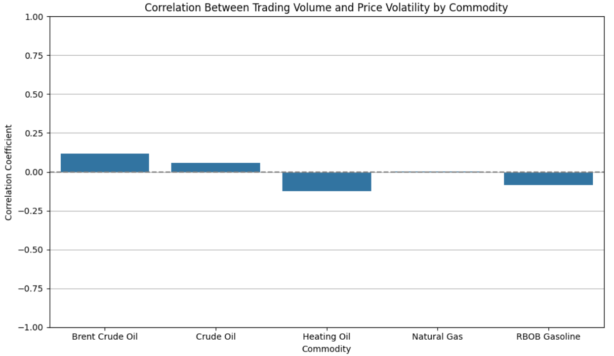
What is the relationship between trading volume and price volatility?
Observations

Slide 17
Section 3: Conclusion
Overall, there is no strong or consistent relationship between trading volume and price volatility for these commodities. This suggests that other market factors play a more significant role in driving price movements than trading activity alone.

Slide 18
Thank you
If you have any feedback, suggestions for future improvements, or questions, please don’t hesitate to reach out at nikhil.ankam@utoledo.edu.

